Slide 1

Enhancing Neural Network Training Through GA & MCTS
MCTS guided Genetics algorithm
Supervisor: Prof. Abdelgayed Fathy
Optimization Techniques || AIE213
Spring 2025

Slide 2
Name | ID | Program
Aser Mohamed Ali | 222102487 | AIS
Mahamed Mahmoud Hamed Soliman | 222200006 | AIE
Abanoub Maged Ageb | 222100001 | AIS
Nada Abdelkarim Ahmed | 222101758 | AIS
Mohamed Rady Salah | 222200004 | AIS

Slide 3
Introduction
Neural Networks (NN) are powerful models used in classification, prediction, and decision-making tasks.
The performance of NNs heavily depends on the optimization of their weights.
Traditional training methods (like backpropagation) may not always find the best solutions.
This project explores a hybrid optimization method combining MCTS, GA, and NN.

Slide 4
Problem Statement
Problem: Poorly optimized NN weights can lead to low accuracy and ineffective learning.
Goal: Improve weight optimization using intelligent search and evolution techniques.

Slide 5
Dataset Description
Dataset: ('Pima Indians Diabetes Database.csv’)
Its subject is 768 Pima Indian women, aged 21 or older
Dataset Features: Age, Body Mass Index (BMI), Diabetes pedigree function, Triceps skinfold thickness, Diastolic blood pressure, Plasma glucose concentration after two hours, Number of pregnancies
Its Outcome: Binary variable indicating the presence of diabetes according to WHO standards
Provides insights into genetic and lifestyle factors affecting diabetes in the Pima Indian community.

Slide 6
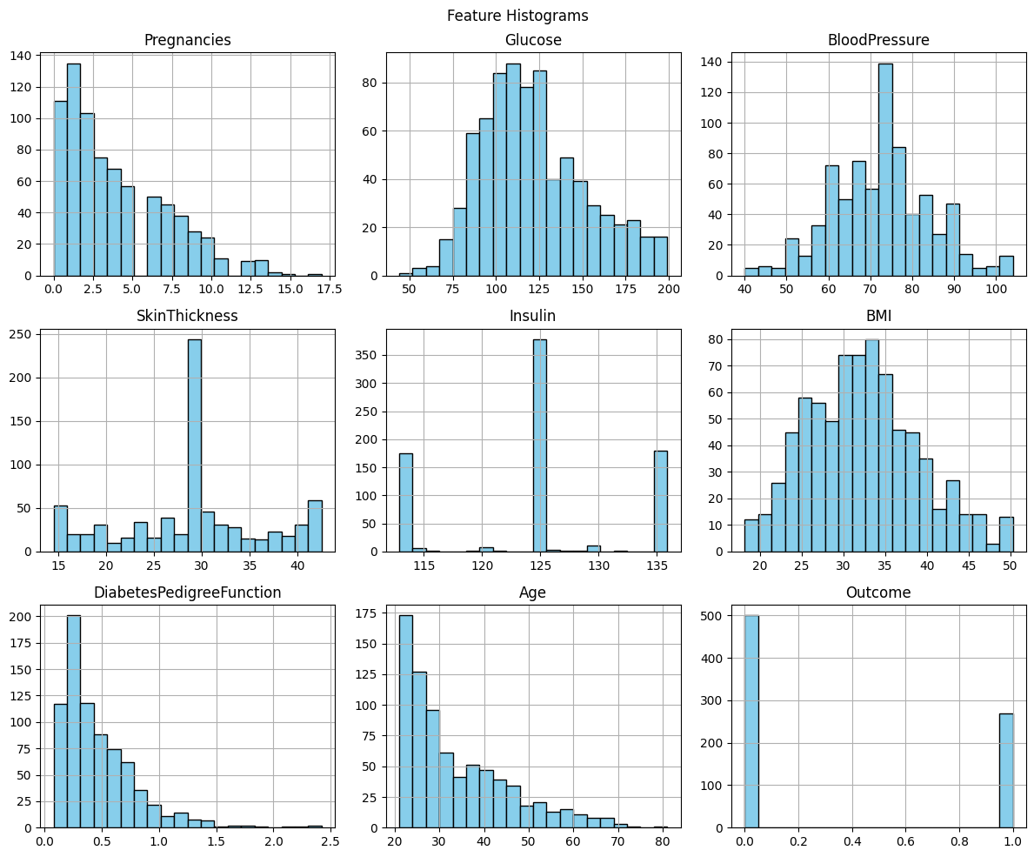
Dataset Visualization of (Preprocessing)

Slide 7
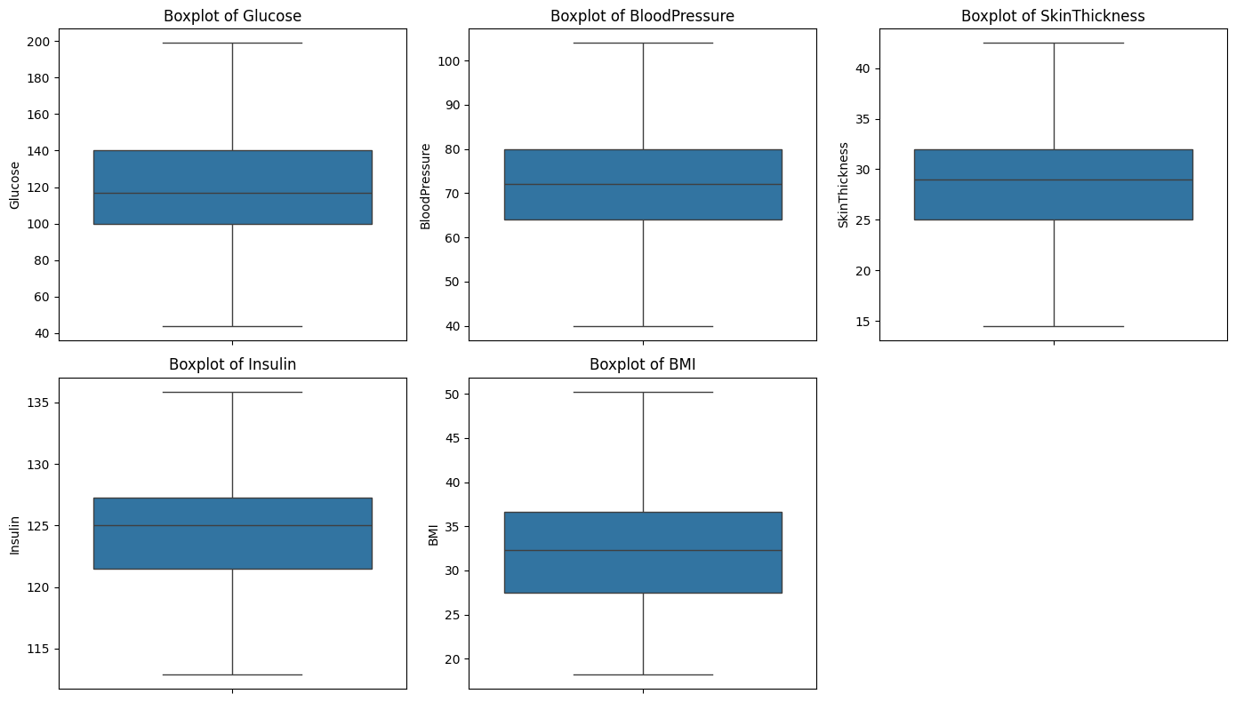
Histogram

Slide 8
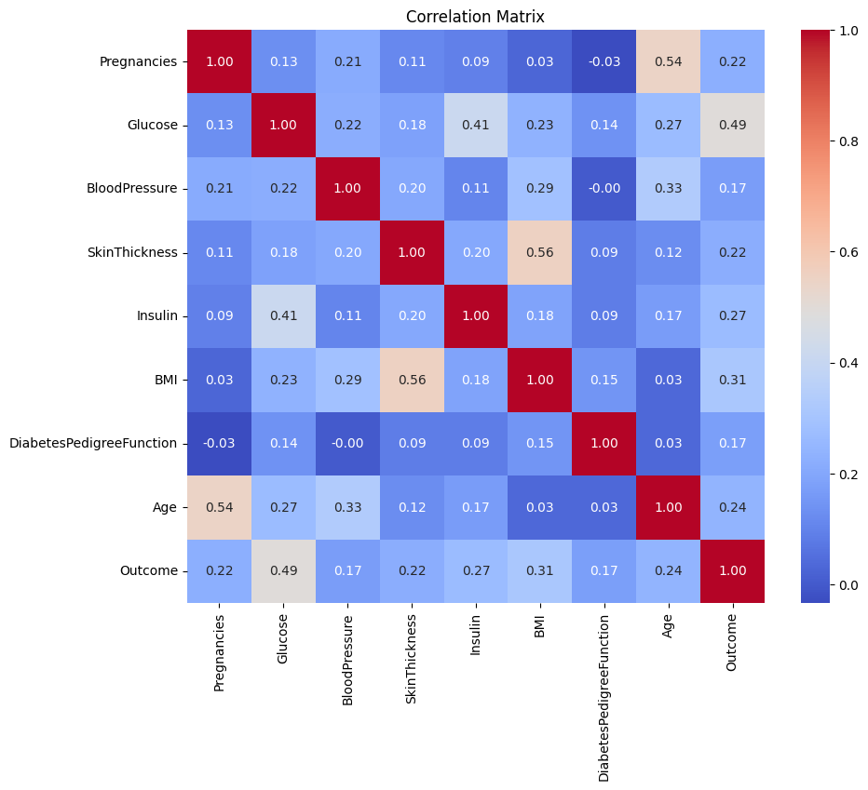
Heatmap

Slide 9
Hybrid Method
Monte Carlo Tree Search
MCTS
Genetic Algorithm
GA
Neural Network
NN

Slide 10
Algorithms Overview
Genetic Algorithm (GA)
Evolution-based optimization.
Uses selection, crossover, and mutation to evolve better solutions.
Monte Carlo Tree Search (MCTS)
Explores possible actions using simulations.
Balances exploration of new options and exploitation of known good ones.
Neural Network (NN)
Learns patterns from data.
Accuracy depends on initial weight values and training process.

Slide 11
Results
After performing several models on the dataset we were able to produce the following results:
(Demonstrated significant improvement over traditional methods)
 | Accuracy
Artificial NN
 | Loss | Accuracy
Adagrad | 0.483285 | 0.769481
Nadam | 0.493560 | 0.759740
Adam | 0.502485 | 0.750000
RMSprop | 0.502819 | 0.740260
Genetic Algorithm |  | 91%
GA + MCTS |  | 89.5%

Slide 12
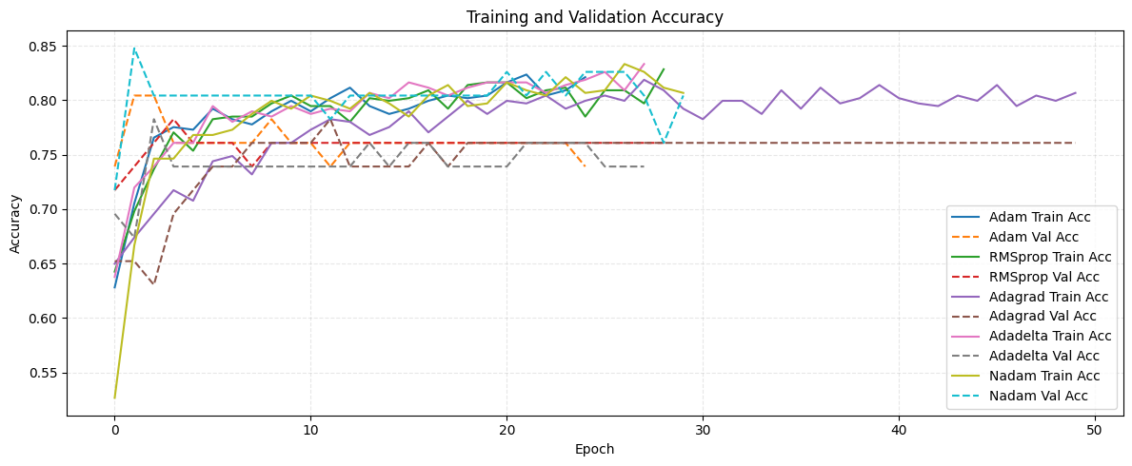
NN Training and Validation Accuracy

Slide 13
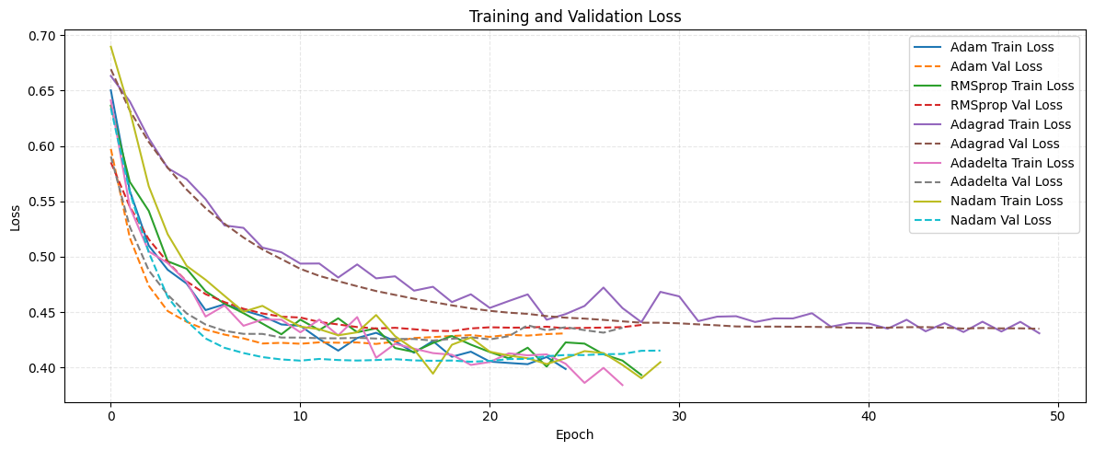
NN Training and Validation Loss

Slide 14
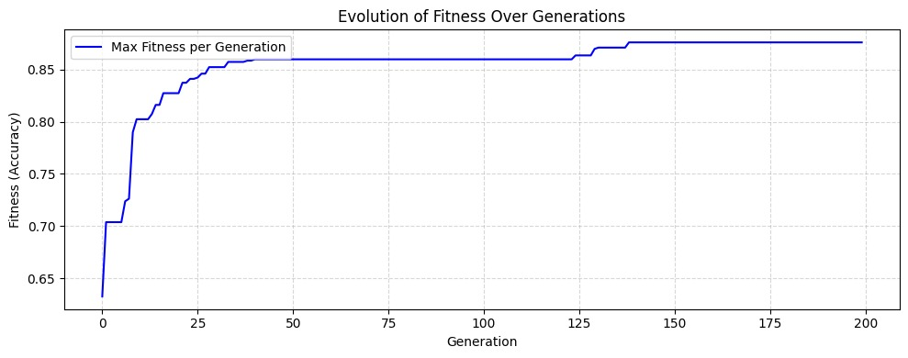
GA Evolution of Fitness over Generations

Slide 15
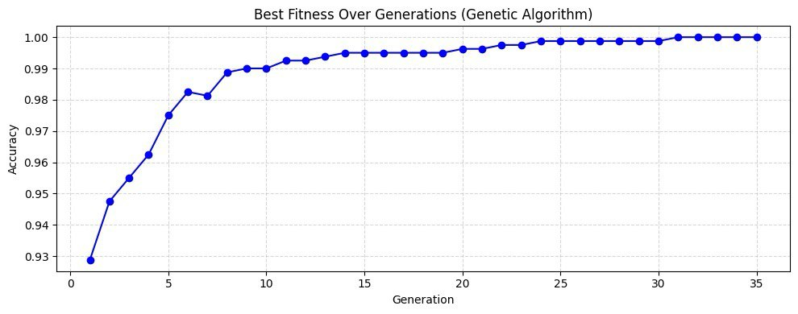
GA Best Fitness over Generations

Slide 16
Future Work
Combine MCTS with other heuristic algorithms to improve performance.
Use adaptive strategies to better tune GA and MCTS parameters.
Apply parallelization techniques to reduce optimization time.

Slide 17
CONCLUSION
The MCTS-GA-NN hybrid method successfully enhances neural network performance through intelligent optimization.
By combining search, evolution, and learning, the approach finds better weight configurations than traditional methods.
However, there might be a need for improvement since it was quite a challenge to preform it due to resources and time limitation.

Slide 18
References
[1] A. Hebbar, “MCTS guided Genetic Algorithm for optimization of neural network weights,” arXiv preprint arXiv:2308.04459, 2023. [Online]. Available: https://arxiv.org/abs/2308.04459
[2] UCI Machine Learning Repository, “Pima Indians Diabetes Database,” Kaggle. [Online]. Available: https://www.kaggle.com/datasets/uciml/pima-indians-diabetes-database/data (accessed May 30, 2024).
[3] L. Xie and A. Yuille, “Genetic CNN,” in Proc. IEEE Int. Conf. Comput. Vis. (ICCV), 2017, pp. 1379–1388. doi: 10.1109/ICCV.2017.153.
[4] S. N. Sivanandam and S. N. Deepa, Introduction to Genetic Algorithms. Springer, 2008. doi: 10.1007/978-3-540-73190-0.
[5] D. Silver, A. Huang, C. J. Maddison, et al., “Mastering the game of Go with deep neural networks and tree search,” Nature, vol. 529, pp. 484–489, 2016. doi: 10.1038/nature16961.
[6] D. Dua and C. Graff, “Pima Indians Diabetes Dataset,” UCI Machine Learning Repository, 2017. [Online]. Available: https://archive.ics.uci.edu/ml/datasets/pima+indians+diabetes
[7] O. I. Abiodun, A. Jantan, A. E. Omolara, et al., “State-of-the-art in artificial neural network applications: A survey,” Heliyon, vol. 4, no. 11, e00938, 2018. doi: 10.1016/j.heliyon.2018.e00938.

Slide 19
Thank you

